Slide 1

Outline:
Calgary Zone Progress with CII/CPAR
Aug 25, 2020
By: Jillian Bates, ACTT Consultant
For: CAPPAC
Why CII/CPAR?
Calgary Zone Progress
Schedule B and CII/CPAR
From Vision to Operations
Q & A

Slide 2

Why CII/CPAR?
Community Information Integration/
Central Patient Attachment Registry

Slide 3


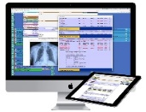


Dr. Heidi Fell (CFPCN)
Community
Physician Office
x3
eNotification
Emergency
Notes:
“I have a young adult woman in my practice for whom I received three notification of ER visits within one week for IV hydration needed for cannabis hyperemesis syndrome. Because of these notifications, I was able to connect with her to start working on the underlying anxiety from COVID 19 which had caused her to start smoking marijuana again. After a couple of virtual visits, she is now doing much better and has been connected to resources to help with her anxiety, hopefully preventing any further ER visits. She had not intended to contact me, but was very grateful that I had reached out.”
- Dr. Heidi Fell, Symons Valley Firstcare, Calgary (CFPCN)

Slide 4
“All of us that have access to Netcare understand how valuable it is and yet there has been a fundamental gap in information. Primary care providers know their patient’s best yet they can’t share that information in Netcare. CII/CPAR is a nice step to rectify that gap.”
Dr. Barney Truong, Mosaic PCNPCN)
Notes:
Dr. Barney Truong M.D., CCFP
MPCN CII/CPAR Physician Project Lead
MPL Board Member
Large non-English speaking population – so especially important to have clear information available in Netcare
Dr Truong is looking forward to contributing to “Patient Summaries” as a future feature of CII/CPAR

Slide 5
“All of us that have access to Netcare understand how valuable it is and yet there has been a fundamental gap in information. Primary care providers know their patient’s best yet they can’t share that information in Netcare. CII/CPAR is a nice step to rectify that gap.”
Dr. Barney Truong, Mosaic PCN
“I have been doing panel management for years and CII/CPAR was not logical step … I also wanted to close the gap and know in a timely way when my patients presented to ER, had surgery, were hospitalized and why, before they showed up in clinic expecting me to know this information.”
Dr. Lisa Stevenson (CWC PCN)
Notes:
Lisa works at Richmond Square Medical and lead the 20 primary care physicians with support of Clinic Manager and PCN staff to get them all on CII.CPAR.

Slide 6
“All of us that have access to Netcare understand how valuable it is and yet there has been a fundamental gap in information. Primary care providers know their patient’s best yet they can’t share that information in Netcare. CII/CPAR is a nice step to rectify that gap.”
Dr. Barney Truong, Mosaic PCN
“I have been doing panel management for years and CII/CPAR was next logical step…I also wanted to close the gap and know in a timely way when my patients presented to ER, had surgery, were hospitalized and why, before they showed up in clinic expecting me to know this information.”
Dr. Lisa Stevenson (CWC PCN)
“Participating in CII has been a time saver for both the ER and the PCN and has resulted in improved quality of care, consistency in treatment plan implementation and improved patient outcomes.”
Bow Valley PCN, Chronic Pain Clinic Team
Notes:
Primary Care physicians that offer specialty care can have their consult reports uploaded to Netcare through participation in CII - and that is what the Bow Valley PCN pain clinic has implemented.
They don’t need paper in binders in the ED to keep track of patients care plans – as they have access to their latest consult report in Netcare

Slide 7




CII and CPAR were at the Request of Physicians
The Central Patient Attachment Registry (CPAR) was at the request of Family Medicine (SGP at the time).
A commitment was made to build this technical enabler for continuity of care.
Alberta’s community specialists requested technology to submit consult reports to Netcare (Community Information Integration (CII)) at AMA Rep Forum
Partners:
Notes:
Community Information Integration and Central Patient Attachment Registry
CII/CPAR is something physicians have been asking for.
This group knows the importance of Relational Continuity. CPAR was asked for as a technical enabler to support important work towards continuity of care.
October of 2016 the Amending Agreement was ratified between Alberta Health and the AMA.
Commitment from both parties to develop the Central Patient Attachment Registry as a tool for primary care and a key technical enabler for continuity of care.
In the summer of 2018 the AMA, AHS and AH agreed to merge the two projects of Community Information Integration and CPAR with enhanced value components for continuity.
The ability to upload consult reports to Netcare, CII, was a resolution from AMA specialist representative forum.

Slide 8
What is the Current Progress?

Slide 9
CII/CPAR in Alberta
Over 50,000 consult reports in Netcare from community-based providers
Over 160,000 Albertans now have a Community Encounter Digest (CED) in their Netcare record
Community Based Physicians Live on CII/CPAR (PCN and non-PCN):
316 Family Physicians
130 Specialists
Total of 446 Physicians in 91 Clinics that are now live
Notes:
Data is from Mid August 2020.
Note this data is for all community based physicians in the province and includes primary care and specialists as well as PCN and non-PCN physician members.

Slide 10
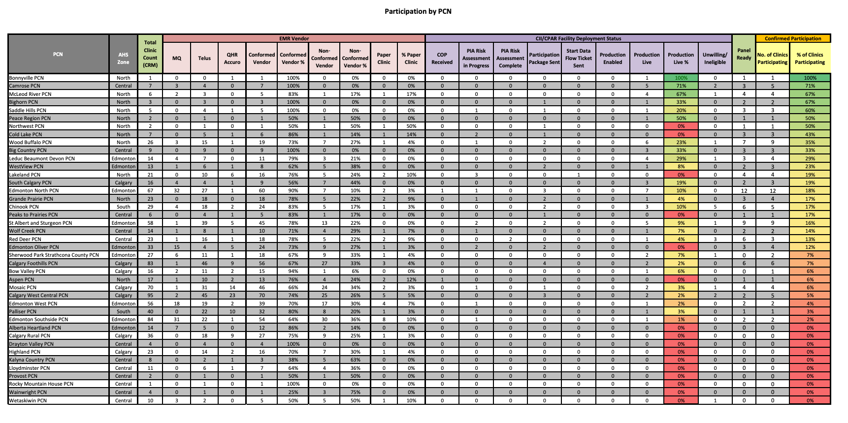
Monthly CII/CPAR participation report by PCN
Notes:
This is monthly CII/CPAR participation report that includes data for all PCNs. I realize you can not read this page and just wanted to jog your memory for what it looks like. This is report you recently received from Kari.
Let’s now dive deeper into Calgary Zone data.

Slide 11
Calgary Zone PCNs: Clinic CII/CPAR Adoption Status
August 2020
NOTES
These graphics represent point in time numbers and are not cumulative. The data is accurate as of August 19, 2020.
The clinic status graphic represent the current number of clinics affiliated with a PCN in each stage of CII/CPAR adoption, as defined in the eHealth Deployment Status Report.
The physician status graphic represents the current number of family physicians and specialists affiliated with a PCN in each stage of CII/CPAR adoption, as defined in the eHealth Deployment Status Report.
Notes:
Calgary Zone - 12 PCN affiliated clinics live (as of Aug 14, 2020)
Deployment Phase CII/CPAR Status
Confirmed
CoP Received
Risk Assessment in Progress
Risk Assessment Complete
Participation Package Sent
In Progress
- Facility Forms Requirements Met
- Start Data Flow Ticket Sent
- Production Enabled
Clinic Live = Production Live

Slide 12
Calgary Zone PCNs: Physician CII/CPAR Adoption Status
August 2020
NOTES
These graphics represent point in time numbers and are not cumulative. The data is accurate as of August 19, 2020.
The clinic status graphic represent the current number of clinics affiliated with a PCN in each stage of CII/CPAR adoption, as defined in the eHealth Deployment Status Report.
The physician status graphic represents the current number of family physicians and specialists affiliated with a PCN in each stage of CII/CPAR adoption, as defined in the eHealth Deployment Status Report.
Notes:
Calgary Zone = 88 physicians live – as of Aug 14, 2020
Deployment Phase CII/CPAR Status
Confirmed
CoP Received
Risk Assessment in Progress
Risk Assessment Complete
Participation Package Sent
In Progress
- Facility Forms Requirements Met
- Start Data Flow Ticket Sent
- Production Enabled
Clinic Live = Production Live

Slide 13
Calgary Zone Physician CII/CPAR Adoption Status
August 2020
Number of Physicians
Notes:
Notes
The data in this graphic is cumulative and updated on a weekly basis.
The total number of PCN member family physicians and specialists was provided by the PCN Operations branch of Alberta Health - Calgary Zone has 1860 PCN Physician members as of Aug 14, 2020
Internal Goals were set to assist with engagement planning and resourcing.
The AH Goal is currently under review and will be updated. It is anticipated it will be at 80% however the time-line is still being discussed.
The Confirmed, In Progress, Live, and Current Live markers represent the number of PCN-affiliated family physicians and specialists in each stage as defined in the eHealth Deployment Status Report.

Slide 14
Calgary Zone PCNs: CII/CPAR Adoption and
Roger’s Diffusion of Innovation Curve
Number of Physicians
Notes:
Notes
Calgary Zone Physician Numbers applied to Roger's Diffusion of Innovation Curve (Flattened)
The total number of PCN- member family physicians and specialists (1860) was provided by the PCN Operations branch of Alberta Health – data as of Aug 14, 2020
Current Live marker represents the number of family physicians and specialists that are PCN members - live on CII/CPAR as defined in the eHealth Deployment Status Report.
The Valley of Death represents the difficult transition between early adopters and the early majority.
The tipping point occurs between the early majority and the late majority and is the point where adoption rates should increase rapidly.

Slide 15
Schedule B - PMH Readiness Indicator
Added to the Grant Agreement for 2020-21 fiscal year
Toolkit is expected later in 2020
  Working group begins Sept. 2020 (AMA/ACTT, AHS and AH)
Indicators appear to be: Panel, CII/CPAR readiness, CII/CPAR adoption, and panel conflict management
Appears to be strong alignment between the monthly CII/CPAR PCN Status Reports* and indicators (7 of 9)
*Distributed by eHealth to PCN E.D’s and identified PCN staff involved in CII/CPAR strategy
This document is prepared by and for AMA ACTT members to assist in an early understanding of the new Schedule B PMH Readiness Indicator. This document is not official. It is designed to provide practical understanding of potential alignment.
Notes:
Panel and CPAR related indicators were released in the new Grant Agreement and Schedule B.
The new indicator is called “Patient’s Medical Home Readiness” however, PMH readiness is far broader than a single indicator. These appear to be panel, CII/CPAR readiness and adoption indicators.
We believe there is strong alignment with 7 of 9 indicators with current monthly CII/CPAR report. We have heard some PCNs express concerns over the accuracy of these reports – especially a couple in Calgary – Schedule B will hopefully give us the opportunity to clarify data definitions and get at best source of truth of information. Please know your ED’s are actively working towards ensuring there is accurate data.
Please note the disclaimer on the bottom – this is ACTT’s current best guess and early understanding. The toolkit, including definitions will be created jointly with AMA/ACTT, AHS and AH.

Slide 16
CII/CPAR from Vision to Operations
From Your Board to PCN Operations
(from 5% to 80%)
Notes:
We should celebrate the 5% of physician in Calgary on CII.CPAR but also now need to focus on the ramp up to 80%.
The data we have shown you only tells the story of physicians in progress with implementation or live with CII.CPAR. Several Calgary PCNs have had significant recent focus on new engagement strategies for improving uptake.

Slide 17
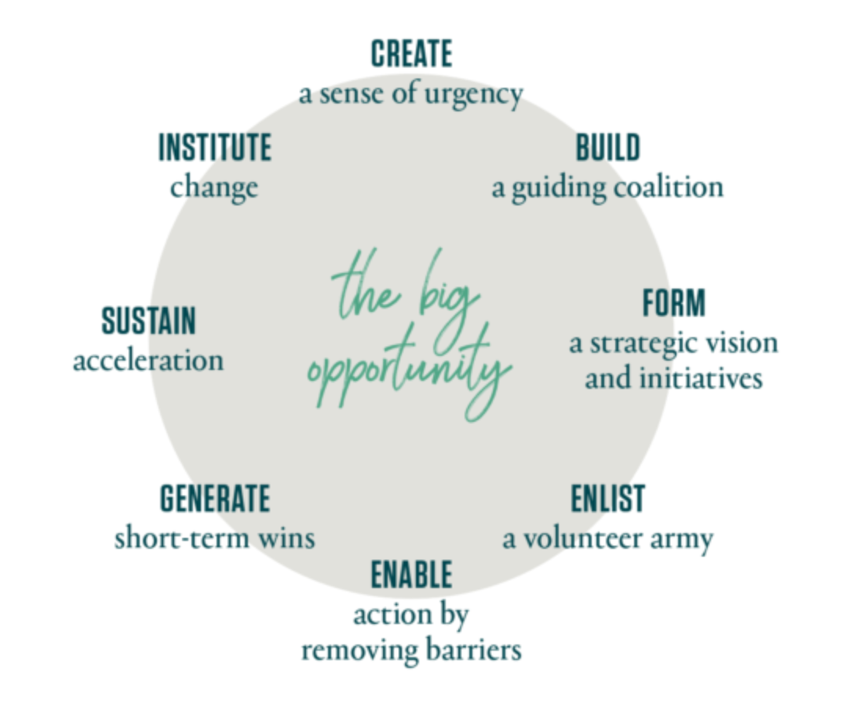
Leading Change: What factors ensure success?
Visible leadership
Senior team alignment
Communicating while being engaging (need the ‘why’)
Linking change to work underway (avoid change fatigue)
Assigning resources
The 8-Step Process for Leading Change; J. Kotter
https://www.kotterinc.com/8-steps-process-for-leading-change/
Notes:
There are many different change management models and articles on how to support a successful change.
I am hoping we can have a discussion regarding:
What do you think, at a Board or Sponsor level, are the most important factors for ensuring success – or As a Board how might you increase the adoption of CII/CPAR?
Here is list of some top sponsor level activities you might consider. Also on the page is Dr. John Kotter’s “8 Step process for Leading Change” – that might help generate some ideas.

Slide 18
What do you think are your most important next steps to take?

Slide 19
Have you chosen to participate in CII/CPAR?
Questions?
ACTT support:
Jillian.Bates@albertadoctors.org
Kari.Remington@albertadoctors.org

